Slide 1
Strategic Insights for Rockbuster Stealth: From Stores to Streaming

Slide 2
Outline
Introduction
Data Overview
Business Questions and Analysis
Recommendations
Q&A

Slide 3
Introduction
Facing stiff competition from streaming services such as Netflix and Amazon Prime, the Rockbuster Stealth management team is planning to use its existing movie licenses to launch an online video rental service in order to stay competitive.
Under the leadership of Rockbuster Stealth’s business intelligence (BI) department, this analysis has been conducted to support the launch strategy of the new online video service.
To this end, this analysis responds to key questions asked by the management team about e.g., revenue contribution by movies, customer geography, sales by region, etc.

Slide 4
Overview of the Data
In this analysis, a data set has been used that contains information about Rockbuster’s film inventory, customers, and payments, among other things.
Describe the data sources you worked with (e.g., rental data, customer data, geographic data, etc.).
Mention how the data was loaded into the RDBMS and prepared for analysis.
Key Metrics/Variables
Provide an overview of the key metrics you analyzed (e.g., revenue per movie, rental duration, geographic distribution of customers).

Slide 5
Business Questions and Analysis
The Rockbuster Stealth Management Board has asked a series of business questions, and they expect data-driven answers that they can use for their 2020 company strategy. Here are the main questions they’d like to answer:
What is the average rental duration for all videos?
Top 10 countries with the highest number of customers?
Top 10 cities with the highest number of customers?
Which movies contributed the most/least to revenue gain?
Where are customers with a high lifetime value based?
Do sales figures vary between geographic regions?
Which countries are Rockbuster customers based in?

Slide 6
Overview of Current Movie Rental Service
Our movie rental service company currently offer a selection of 1000 films exclusively in the English language, across 17 different categories in 109 country.
All films are released in 2006.
By Priya Patel

Slide 7
Statistics of Film Rental
Average
Rental Rate - $2.98
Rental Duration - 5 days
Film Length - 115.3 min
Replacement Cost - $19.98
Minimum
Rental Rate - $0.99
Rental Duration - 3 days
Film Length - 46 min
Replacement Cost - $9.99
Maximum
Rental Rate - $4.99
Rental Duration - 7 days
Film Length - 185 min
Replacement Cost - $29.99
By Priya Patel

Slide 8
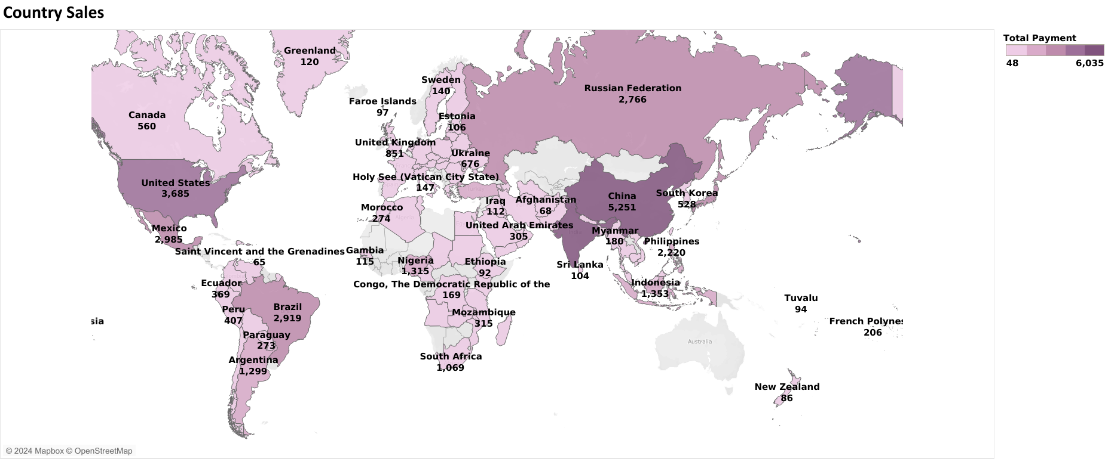
Sales Figures vary between Geographic Regions
Sales shown variation across different geographic regions.
High figures observed in certain countries within Asia and America.
By Priya Patel

Slide 9
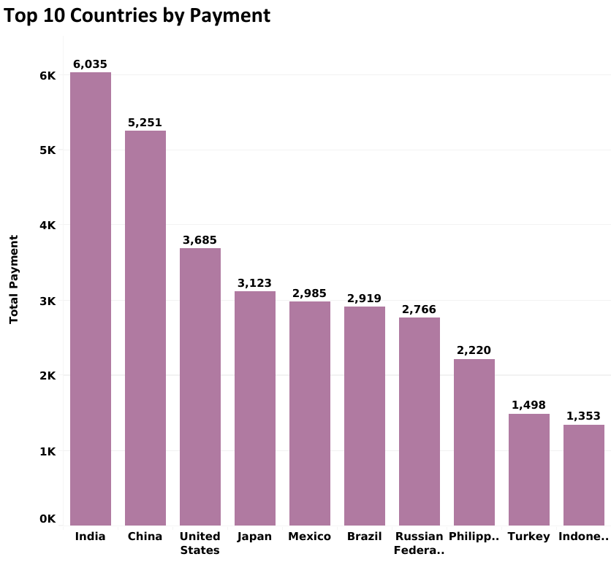
Customer Presence by Country
Our current rental service has the largest market base in India and China.
Expanding our movies selection to include local languages in India and China.
By Priya Patel

Slide 10
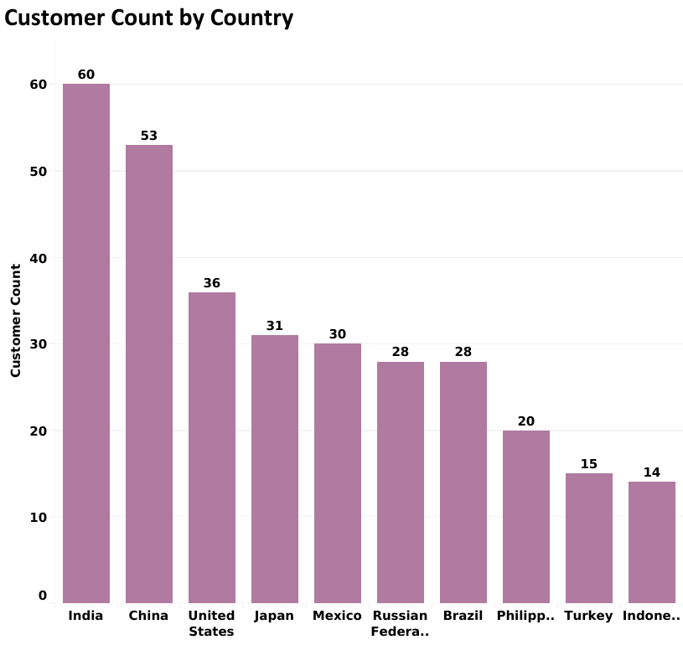
Customer Count by Payment
Our current rental service has the highest customer in India and China.
India and China customers make highest revenue.
By Priya Patel

Slide 11
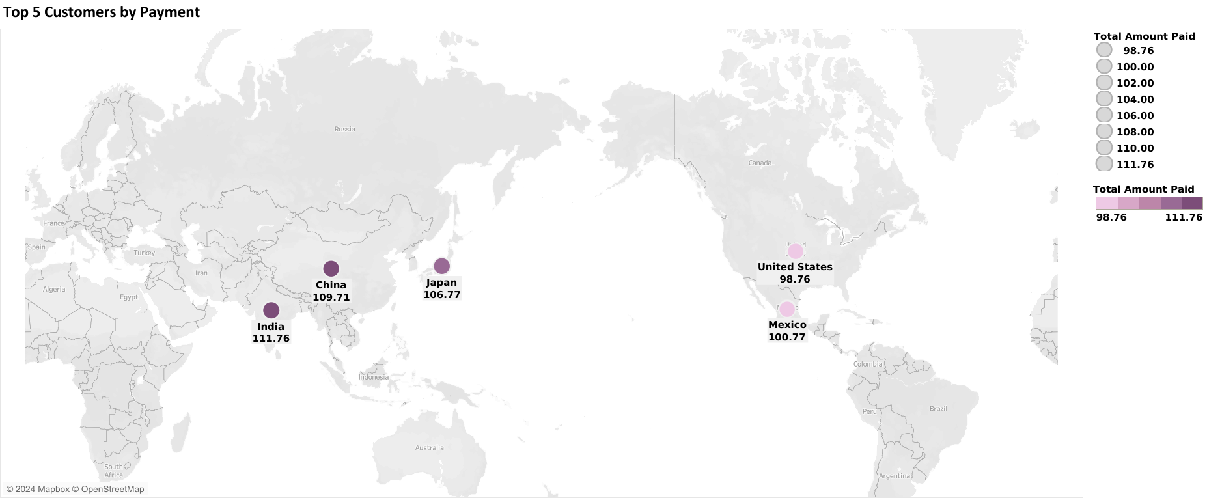
Top 5 Customer by Payment
These are the top 5 customers from the top two countries, India and China.
Asia has highest customers.
By Priya Patel

Slide 12
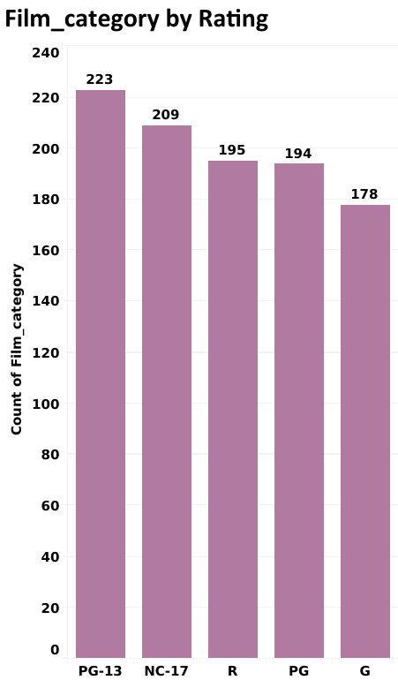
Analysis by Film Category
PG-13 contributed the most to the revenue.
PG-13 has the most popular film rating.
By Priya Patel

Slide 13
Recommendation
India, China, and America which the largest customer bases.
Expanding our movie selection to include local languages in India and China, has the potential to broaden our customer base in these two countries.
These results suggest the allocating more marketing resources to Asia and America.
These results suggest focusing film selection and marketing resources on the genres, along with the PG-13 rating.
To reduce costs on movie licenses, consider discontinuing current movies with minimal or no rental history. This approach ensures a more efficient allocation of resources by focusing on movies that have a higher rental demand.
By Priya Patel

Slide 14
Q&A

